Slide 1








PROBLEM STATEMENT AND DEFINITIONS
Our aim is to apply an anomaly detection algorithm to the data distributed in a network.
We consider a sensor network topology in which a set of sensors
are connected in a hierarchical tree topology to a sink B
Over a fixed monitoring period, each node observes a set of measurements
where each measurement is a vector of values observed at the node
for example, in a monitoring application these values can be temperature, humidity, and light intensity
Our goal is to partition the set X of measurements from all nodes into normal measurements and anomalous measurements

Slide 2





PROBLEM STATEMENT AND DEFINITIONS
that is,
We assume that all of the normal measurements at node are drawn from the same distribution are the population mean and covariance of the distribution.
Not all the nodes necessarily have the same distributions of measurements, so across the whole network, normal measurements
are drawn from a mixture of c possible distributions

Slide 3
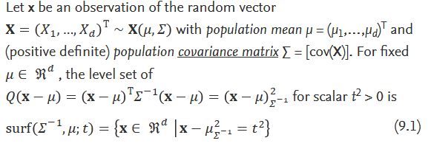
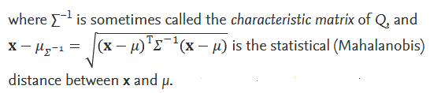
HYPERELLIPSOIDAL ANOMALY DETECTION
Hyper ellipsoids are remarkably flexible and can capture the central tendencies of a wide range of datasets.
We introduce the formulas for calculating a hyper ellipsoidal decision boundary to detect anomalies.

Slide 4
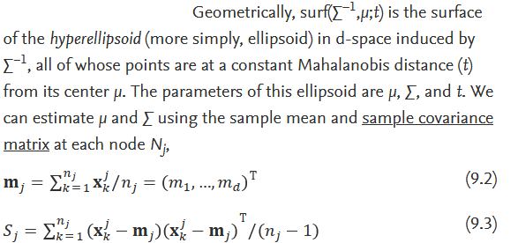
HYPERELLIPSOIDAL ANOMALY DETECTION

Slide 5
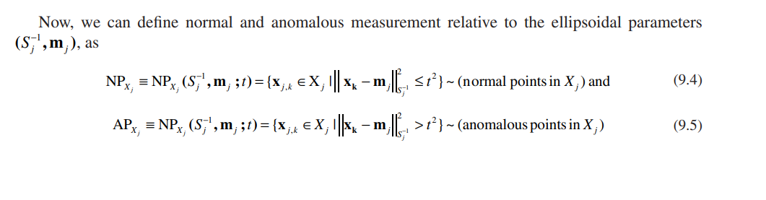
HYPERELLIPSOIDAL ANOMALY DETECTION

